Slide 1
DBMS Transaction State

Slide 2
Introduction
If transaction complete successfully it may be saved to database server called as committed transaction
A committed transaction transfers database from one consistent state to other consistent state.
Transaction may not complete its execution successfully. Such transaction is called as aborted.

Slide 3
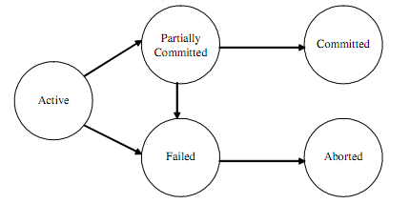

Slide 4
Active State
When the instructions of the transaction is running then the transaction is in active state.
If all the read and write operations are performed without any error then it goes to “partially committed state”, if any instruction fails it goes to “failed state”.
The active state is the first state of every transaction. In this state, the transaction is being executed.

Slide 5
As soon as transaction execution starts it is in active state.
Transaction remains in this state till transaction finishes.

Slide 6
Partially committed
In the partially committed state, a transaction executes its final operation, but the data is still not saved to the database.
As soon as last operation in transaction is executed transaction goes into partially committed state.
At this condition the transaction has completed its execution and ready to commit on database server,

Slide 7
But it is still possible that it may be aborted as the actual output may be there in main memory and thus hardware failure may prohibit its successful completion.

Slide 8
Failed state
A transaction enters into failed state after the system determines that the transaction can no longer proceed with its normal execution.
Eg: in case of hardware or logical errors while execution.

Slide 9
Aborted
Failed transaction must be rolled back. Then it enters the aborted state.
Transaction has been rolled back restoring into prior state.
In this stage we have two options:
Restart the transaction
Kill the transaction

Slide 10
Restart the transaction
A restarted transaction is considered to be a new transaction which may recover from possible failure.

Slide 11
Kill the transaction
Because the bad input or because the desired data were not present in the database an error can occur. In this case we can kill transaction to recover from failure.

Slide 12
committed
If a transaction completes the execution successfully then all the changes made in the local memory during partially committed state are permanently stored in the database

Slide 13
Transaction schedule
transactions are set of instructions and these instructions perform operations on database.
When multiple transactions are running concurrently then there needs to be a sequence in which the operations are performed because at a time only one operation can be performed on the database.
This sequence of operations is known as Schedule.

Slide 14
Representation
RT(X): denotes read operation performed by the transaction T on object X
WT(X): denotes write operation performed by the transaction T on object X

Slide 15
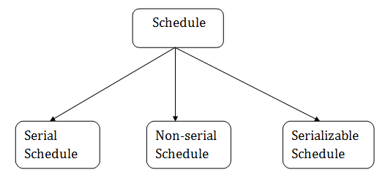

Slide 16
Thank you !

